Slide 1


CSE3078 – Cryptography and Network Security
School of Computer Science and Engineering

Slide 2
Module 2
Private Key Cryptography and Number Theory

Slide 3
Block Ciphers Principles
Many symmetric block encryption algorithms in current use are based on a structure referred to as a Feistel block cipher.
Stream Ciphers and Block Ciphers
A stream cipher is one that encrypts a digital data stream one bit or one byte at a time. Examples of classical stream ciphers are the autokeyed Vigenère cipher and the Vernam cipher.
A block cipher is one in which a block of plaintext is treated as a whole and used to produce a ciphertext block of equal length. Typically, a block size of 64 or 128 bits is used.

Slide 4
The Feistel Cipher
Feistel proposed that we can approximate the ideal block cipher by utilizing the concept of a product cipher, which is the execution of two or more simple ciphers in sequence in such a way that the final result or product is cryptographically stronger than any of the component ciphers.

Slide 5
In particular, Feistel proposed the use of a cipher that alternates substitutions and permutations, where these terms are defined as follows:
Substitution: Each plaintext element or group of elements is uniquely replaced by a corresponding ciphertext element or group of elements.
Permutation: A sequence of plaintext elements is replaced by a permutation of that sequence. That is, no elements are added or deleted or replaced in the sequence, rather the order in which the elements appear in the sequence is changed.

Slide 6
DIFFUSION AND CONFUSION
Shannon suggests two methods for frustrating statistical cryptanalysis: diffusion and confusion.
In diffusion, the statistical structure of the plaintext is dissipated into long-range statistics of the ciphertext. This is achieved by having each plaintext digit affect the value of many ciphertext digits.
In confusion seeks to make the relationship between the ciphertext and the value of the encryption key as complex as possible.

Slide 7
Feistel Cipher Structure
The inputs to the encryption algorithm are a plaintext block of length 2w bits and a key k.
The plaintext block is divided into two halves, L0 and R0.
The two halves of the data pass through rounds of processing and then combine to produce the ciphertext block.
Each round i has as inputs Li-1 and Ri-1 derived from the previous round, as well as a subkey Ki derived from the overall K.
In general, the subkeys Ki are different from K and from each other 16 rounds are used, although any number of rounds could be implemented.

Slide 8
All rounds have the same structure. A substitution is performed on the left half of the data.
This is done by applying a round function F to the right half of the data and then taking the exclusive-OR of the output of that function and the left half of the data.
The round function has the same general structure for each round following this substitution, a permutation is performed that consists of the interchange of the two halves of the data.
This structure is a particular form of the substitution-permutation network (SPN) proposed by Shannon

Slide 9
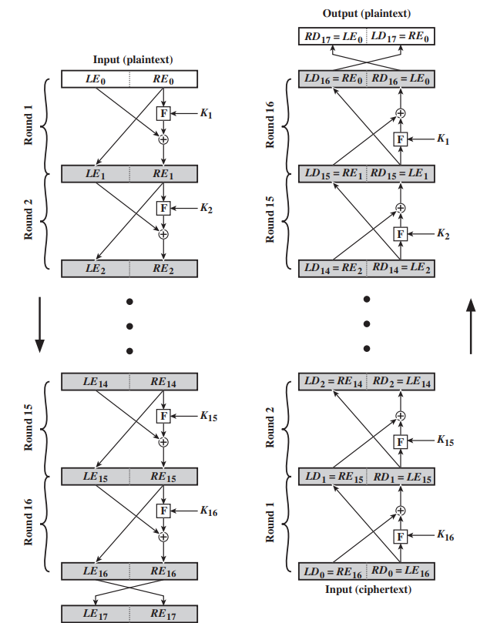
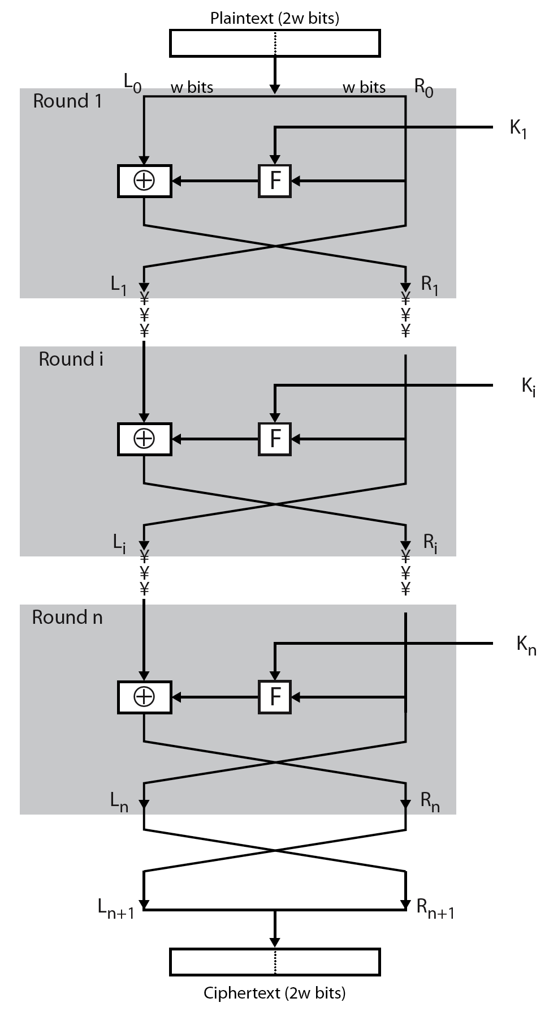
Feistel Encryption and Decryption (16 rounds)

Slide 10
Feistel Cipher Design Elements
Block size:
Larger block sizes mean greater security (all other things being equal) but reduced encryption/decryption speed for a given algorithm.
The greater security is achieved by greater diffusion.
Traditionally, a block size of 64 bits has been considered a reasonable tradeoff and was nearly universal in block cipher design.
However, the new AES uses a 128-bit block size.

Slide 11
Key size:
Larger key size means greater security but may decrease encryption/ decryption speed.
The greater security is achieved by greater resistance to brute-force attacks and greater confusion.
Key sizes of 64 bits or less are now widely considered to be inadequate, and 128 bits has become a common size.

Slide 12
Number of rounds: The essence of the Feistel cipher is that a single round offers inadequate security but that multiple rounds offer increasing security. A typical size is 16 rounds.
Subkey generation algorithm: Greater complexity in this algorithm should lead to greater difficulty of cryptanalysis.
Round function F: Again, greater complexity generally means greater resistance to cryptanalysis.

Slide 13
There are two other considerations in the design of a Feistel cipher:
Fast software encryption/decryption: In many cases, encryption is embedded in applications.
Ease of analysis: To make our algorithm as difficult as possible to cryptanalyze, there is great benefit in making the algorithm easy to analyze.

Slide 14
Data Encryption Standard (DES)
Data Encryption Standard is a symmetric key block cipher published by the National Institute of Standard and Technology (NIST).
It encrypts data in 64-bit block
DES is symmetric key algorithm: The same algorithm and key is used for both encryption and decryption.
Key size is 56-bit
The encryption process is made of two permutations i.e P-boxes, which is called initial and final permutation.
DES uses both transposition and substitution and for that reason is sometimes referred to as a product cipher.

Slide 15
The sets of 64-bits are referred to as blocks.
The cipher consists of 16 rounds.
Each round uses a separate key of 48 bits.

Slide 16
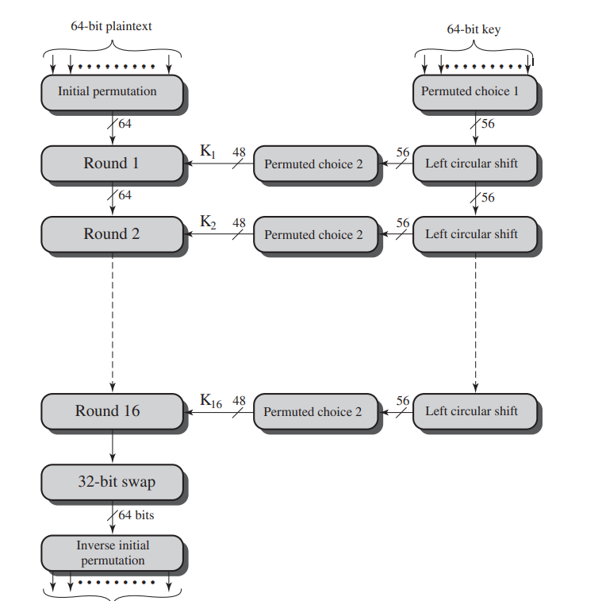
DES Encryption

Slide 17
The overall scheme for DES encryption. As with any encryption scheme, there are two inputs to the encryption function: the plaintext and key.
In this case, the plaintext must be 64 bits in length and the key is 56 bits in length.
The plaintext proceeds in three phases.
First, the 64-bit plaintext passes through an initial permutation (IP) that rearranges the bits to produce the permuted input.
Second phase consisting of sixteen rounds of the same function, which involves both permutation and substitution functions.

Slide 18
The output of the last (sixteenth) round consists of 64 bits that are a function of the input plaintext and the key.
The left and right halves of the output are swapped to produce the preoutput.
Finally, the preoutput is passed through a permutation that is the inverse of the initial permutation function, to produce the 64-bit ciphertext.
With the exception of the initial and final permutations, DES has the exact structure of a Feistel cipher

Slide 19
The 56-bit key is used. Initially, the key is passed through a permutation function.
Then, for each of the sixteen rounds, a subkey ( ) is produced by the combination of a left circular shift and a permutation.
The permutation function is the same for each round, but a different subkey is produced because of the repeated shifts of the key bits

Slide 20
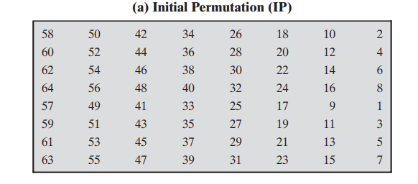
INITIAL PERMUTATION
The initial permutation and its inverse are defined by tables
The input to a table consists of 64 bits numbered from 1 to 64.
The 64 entries in the permutation table contain a permutation of the numbers from 1 to 64.

Slide 21
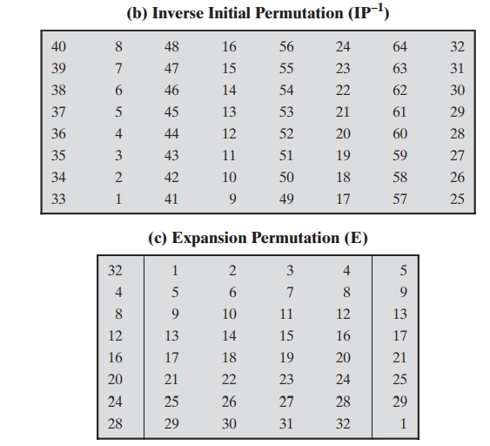

Slide 22
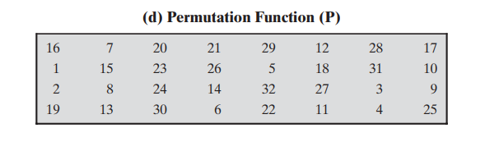

Slide 23
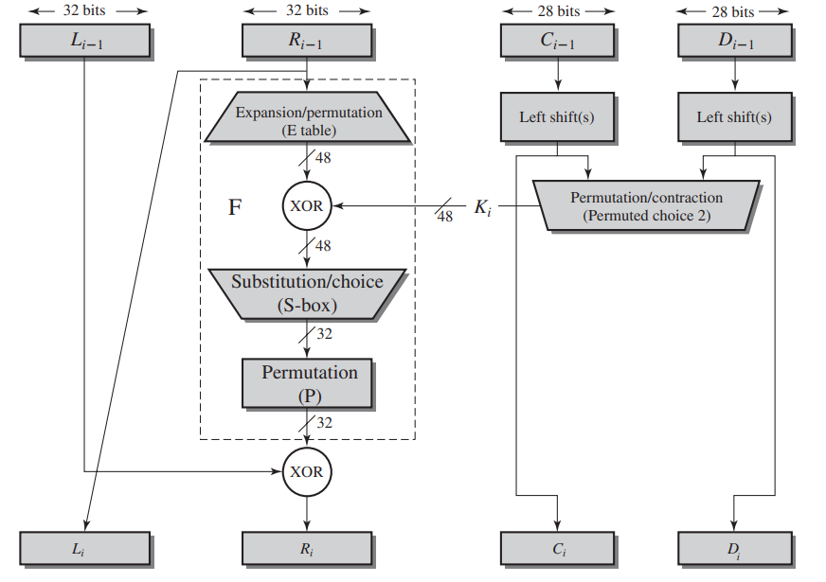
Single Round of DES Algorithm

Slide 24
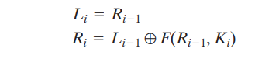
The left and right halves of each 64-bit intermediate value are treated as separate 32-bit quantities, labeled L (left) and R (right).
As in any classic Feistel cipher, the overall processing at each round can be summarized in the following formulas:

Slide 25
The round key is 48 bits.
The input is 32 bits.
This input is first expanded to 48 bits by using a table that defines a permutation plus an expansion that involves duplication of 16 of the bits.
The resulting 48 bits are XORed with Ki.
This 48-bit result passes through a substitution function that produces a 32-bit output.
The role of the S-boxes in the function F.
The substitution consists of a set of eight S-boxes, each of which accepts 6 bits as input and produces 4 bits as output.

Slide 26
The first and last bits of the input to box form a 2-bit binary number to select one of four substitutions defined by the four rows in the table for .
The middle four bits select one of the sixteen columns.
The decimal value in the cell selected by the row and column is then converted to its 4-bit representation to produce the output.
For example, in S1, for input 011001, the row is 01 (row 1) and the column is 1100 (column 12).
The value in row 1, column 12 is 9, so the output is 1001.

Slide 27
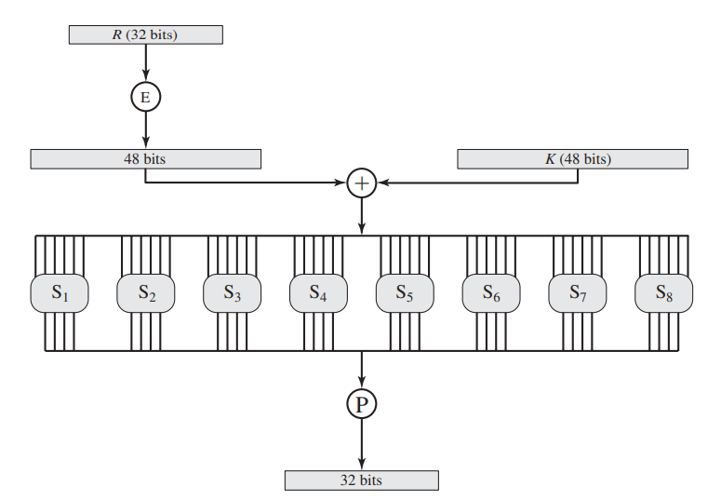

Slide 28
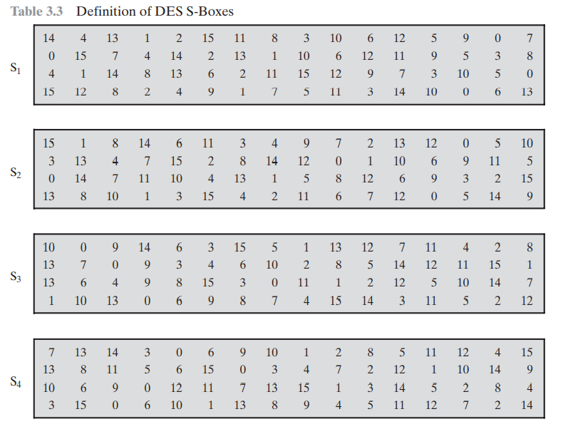

Slide 29
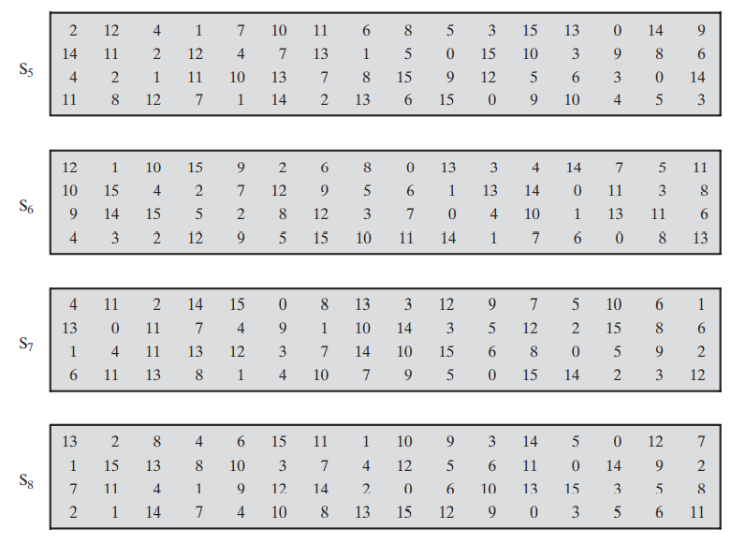

Slide 30
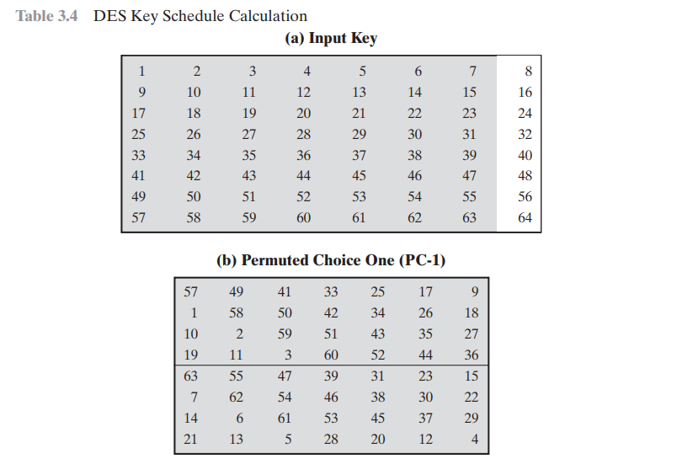

Slide 31
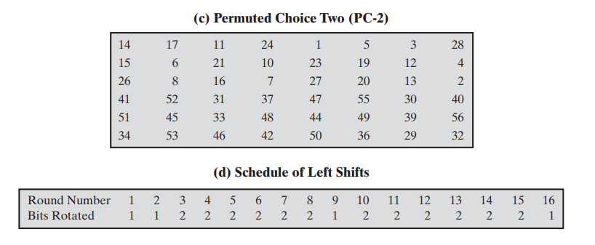

Slide 32
DES Decryption
As with any Feistel cipher, decryption uses the same algorithm as encryption, except that the application of the subkeys is reversed.

Slide 33
The Avalanche Effect
A desirable property of any encryption algorithm is that a small change in either the plaintext or the key should produce a significant change in the ciphertext.
In particular, a change in one bit of the plaintext or one bit of the key should produce a change in many bits of the ciphertext.
This is referred to as the avalanche effect.

Slide 34
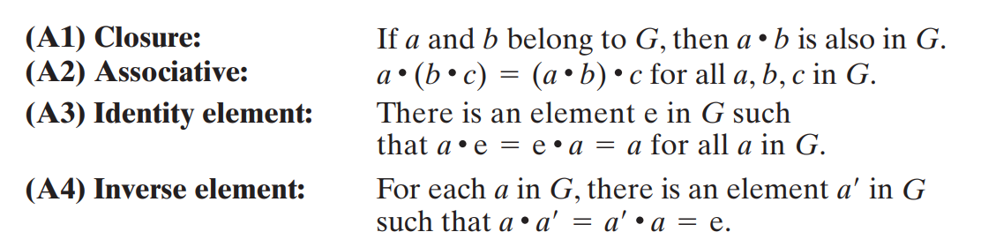
Groups
A group , sometimes denoted by {G, .}, is a set of elements with a binary operation denoted by . that associates to each ordered pair (a, b) of elements in G an element (a . b) in G, such that the following axioms are obeyed:

Slide 35
If a group has a finite number of elements, it is referred to as a finite group, and the order of the group is equal to the number of elements in the group. Otherwise, the group is an infinite group
A group is said to be abelian if it satisfies the following additional condition:
Example:
Is (Z, +) a group?
35

Slide 36
CYCLIC GROUP
A group G denoted by {G, .}, is said to be a cyclic group, if it contains at-least one generator element.
Example
Prove that (G, *) is a cyclic group where G={1, w, w²}

Slide 37
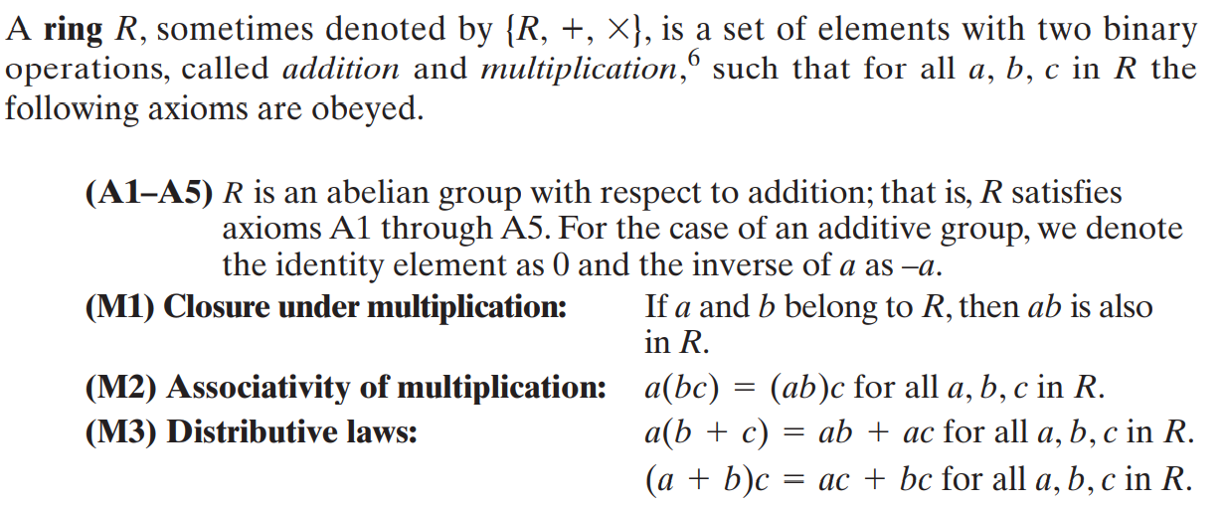
Rings

Slide 38
Commutative ring

Slide 39
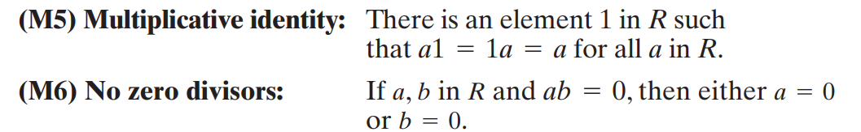
Integral domain
Integral domain, which is a commutative ring that obeys the following axioms

Slide 40
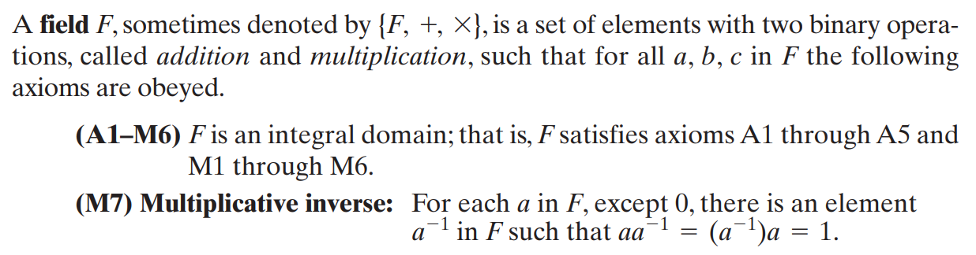
Fields

Slide 41
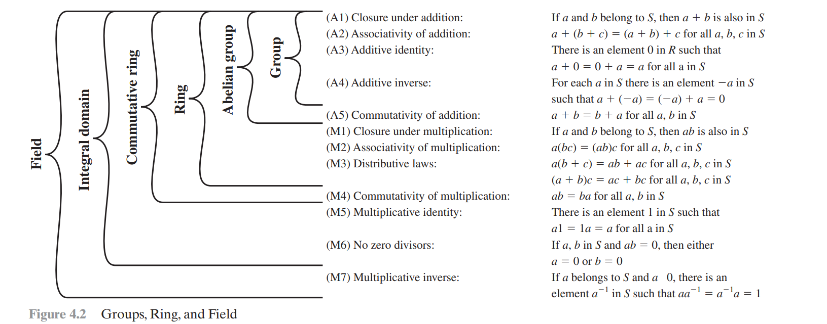

Slide 42
Finite Field
A finite field or Galois field is a field that contains a finite number of elements.
A finite field is a set on which the operations of multiplication, addition, subtraction and division are defined and satisfy certain basic rules.
The most common examples of finite fields are given by the integers (mod p) when p is a prime number.
Application areas:
Mathematics and computer science – Number theory, Algebraic geometry, Galois theory, Finite geometry, Cryptography and coding theory

Slide 43
Finite Fields of the Form GF(p)
Finite fields play a crucial role in many cryptography algorithms.
The order of a finite field(number of elements in the field) must be a power of a prime p^{n}, where n is a positive integer.
The prime number is an integer whose only positive integer factors are itself and 1.
The finite field of order p^{n} is generally written GF(p^{n}); GF stands for Galois field, in honor of the mathematician who first studied finite fields.

Slide 44
Two special cases are of interest for our purposes.
For n = 1, we have the finite field GF(p)
For n>1, we have the finite field GF(p^{n})

Slide 45
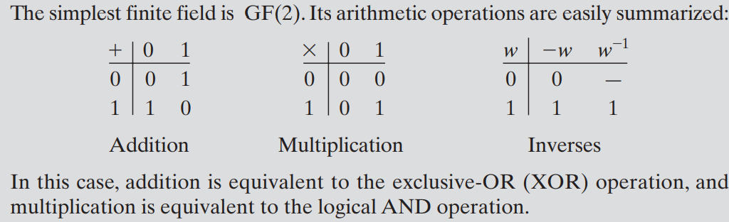
Finite Fields of Order p
For a given prime, p, we define the finite field of order p, GF(p), as the set Z_{p} of integers{0,1, …,p-1} together with the arithmetic operations modulo p.

Slide 46
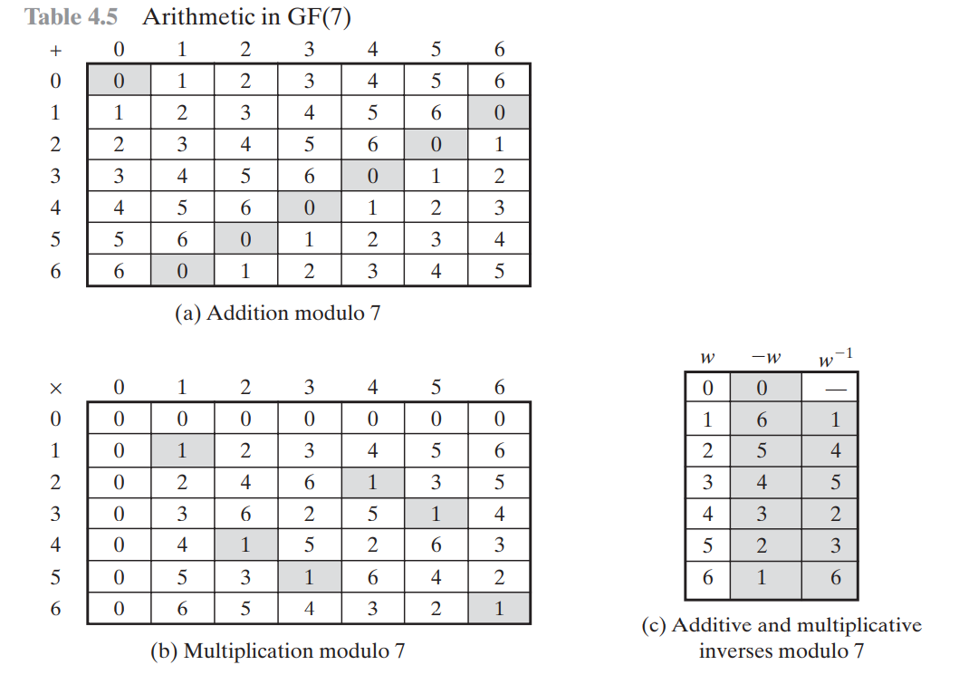
Finding the Multiplicative Inverse in GF(p)

Slide 47
AES Structure
The cipher takes a plaintext block size of 128 bits, or 16 bytes.
The key length can be 16, 24, or 32 bytes (128, 192, or 256 bits).
The algorithm is referred to as AES-128, AES-192, or AES-256, depending on the key length

Slide 48
The input to the encryption and decryption algorithms is a single 128-bit block.
This block is depicted as a 4 x 4 square matrix of bytes.
This block is copied into the State array, which is modified at each stage of encryption or decryption.
After the final stage, State is copied to an output matrix

Slide 49
Similarly, the key is depicted as a square matrix of bytes.
This key is then expanded into an array of key schedule words.
Each word is four bytes, and the total key schedule is 44 words for the 128-bit key.

Slide 50
Note that the ordering of bytes within a matrix is by column.
So, for example, the first four bytes of a 128-bit plaintext input to the encryption cipher occupy the first column of the in matrix, the second four bytes occupy the second column, and so on.
Similarly, the first four bytes of the expanded key, which form a word, occupy the first column of the w matrix.

Slide 51
The cipher consists of rounds, where the number of rounds depends on the key length: 10 rounds for a 16-byte key, 12 rounds for a 24-byte key, and 14 rounds for a 32-byte key.
The first rounds consist of four distinct transformation functions: SubBytes, ShiftRows, MixColumns, and AddRoundKey.
The final round contains only three transformations, and there is a initial single transformation (AddRoundKey) before the first round, which can be considered Round 0

Slide 52
Each transformation takes one or more 4 x 4 matrices as input and produces a 4 x 4 matrix as output.
The output of each round is a 4 x 4 matrix, with the output of the final round being the ciphertext.
Also, the key expansion function generates N + 1 round keys, each of which is a distinct 4 x 4 matrix.
Each round key serve as one of the inputs to the AddRoundKey transformation in each round

Slide 53
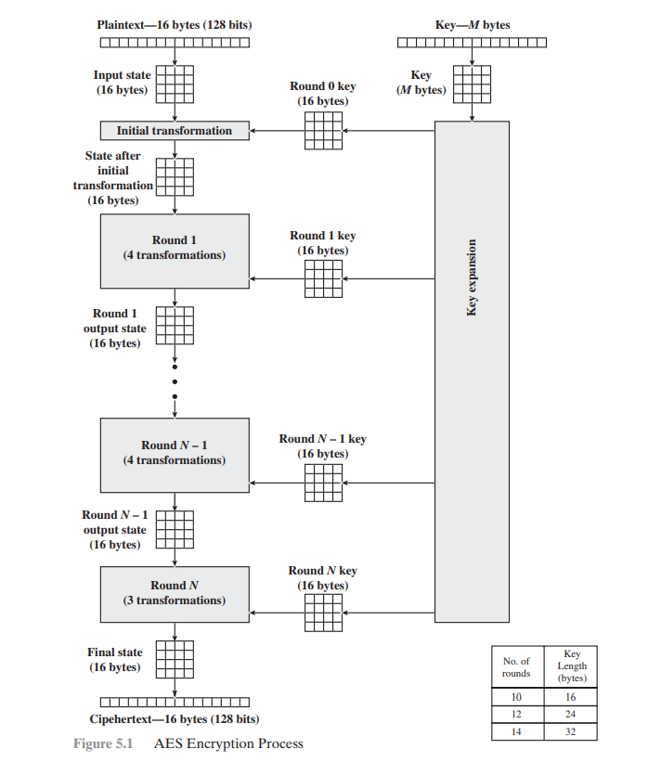

Slide 54
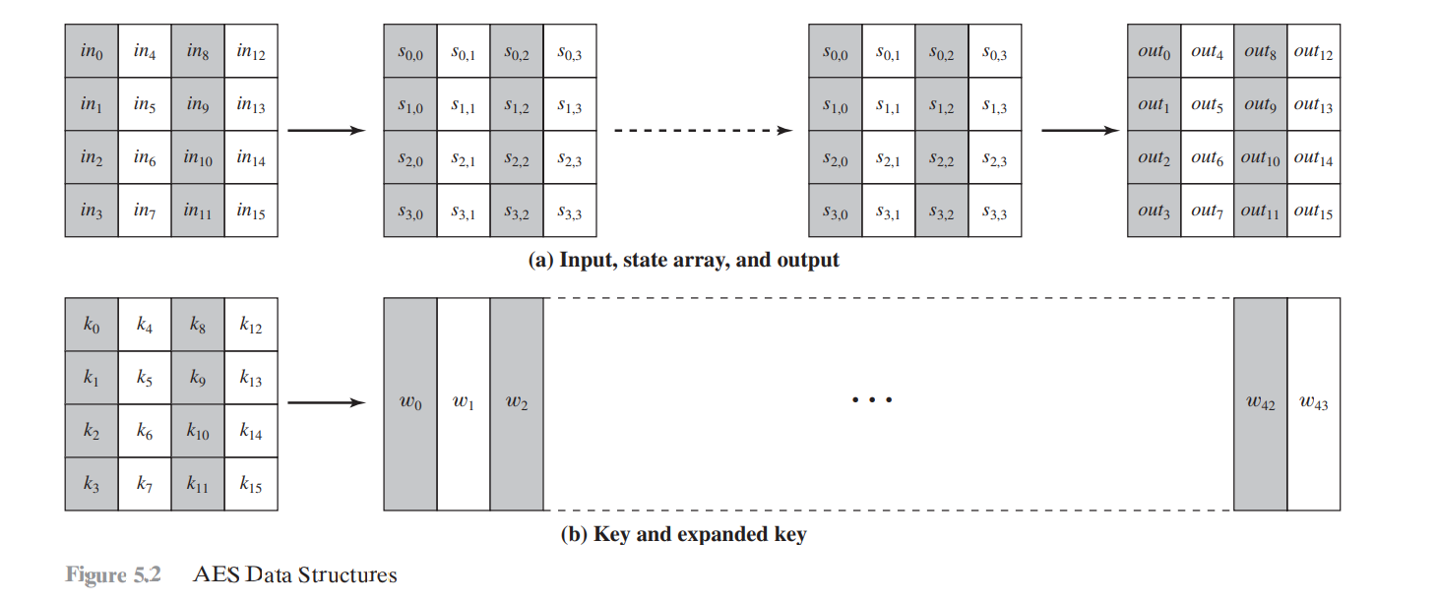
AES Data Structures

Slide 55
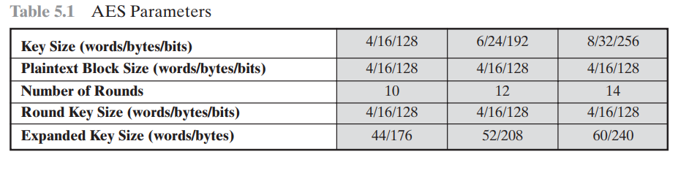
AES Parameters

Slide 56
The overall AES structure
One noteworthy feature of this structure is that it is not a Feistel structure.
Recall that, in the classic Feistel structure, half of the data block is used to modify the other half of the data block and then the halves are swapped.
AES instead processes the entire data block as a single matrix during each round using substitutions and permutation.

Slide 57
The key that is provided as input is expanded into an array of forty-four 32-bit words, w[i]. Four distinct words (128 bits) serve as a round key for each round;

Slide 58
Four different stages are used, one of permutation and three of substitution:
Substitute bytes: Uses an S-box to perform a byte-by-byte substitution of the block
ShiftRows: A simple permutation
MixColumns: A substitution that makes use of arithmetic over GF(2⁸)
• AddRoundKey: A simple bitwise XOR of the current block with a portion of the expanded key

Slide 59
The structure is quite simple. For both encryption and decryption, the cipher begins with an AddRoundKey stage, followed by nine rounds that each includes all four stages, followed by a tenth round of three stages.

Slide 60
Only the AddRoundKey stage makes use of the key.
For this reason, the cipher begins and ends with an AddRoundKey stage.
Any other stage, applied at the beginning or end, is reversible without knowledge of the key and so would add no security.

Slide 61
The AddRoundKey stage is, in effect, a form of Vernam cipher and by itself would not be formidable.
The other three stages together provide confusion, diffusion, and nonlinearity, but by themselves would provide no security because they do not use the key.
We can view the cipher as alternating operations of XOR encryption (AddRoundKey) of a block, followed by scrambling of the block (the other three stages), followed by XOR encryption, and so on.
This scheme is both efficient and highly secure.

Slide 62
Each stage is easily reversible. For the Substitute Byte, ShiftRows, and MixColumns stages, an inverse function is used in the decryption algorithm. For the AddRoundKey stage, the inverse is achieved by XORing the same round key to the block, using the result.

Slide 63
As with most block ciphers, the decryption algorithm makes use of the expanded key in reverse order.
However, the decryption algorithm is not identical to the encryption algorithm.
This is a consequence of the particular structure of AES.

Slide 64
Once it is established that all four stages are reversible, it is easy to verify that decryption does recover the plaintext.
Encryption and decryption going in opposite vertical directions.
At each horizontal point (e.g., the dashed line in the figure), State is the same for both encryption and decryption.

Slide 65
The final round of both encryption and decryption consists of only three stages.
Again, this is a consequence of the particular structure of AES and is required to make the cipher reversible.

Slide 66
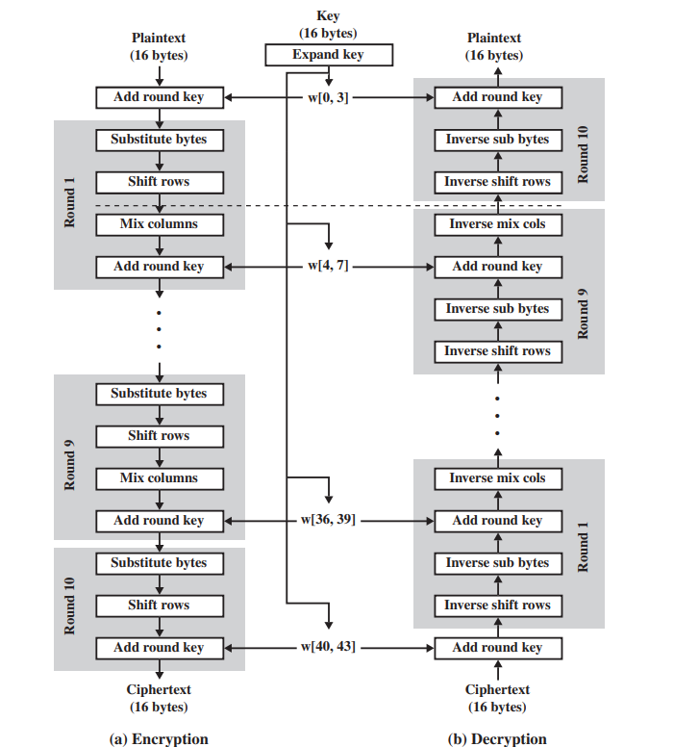

Slide 67
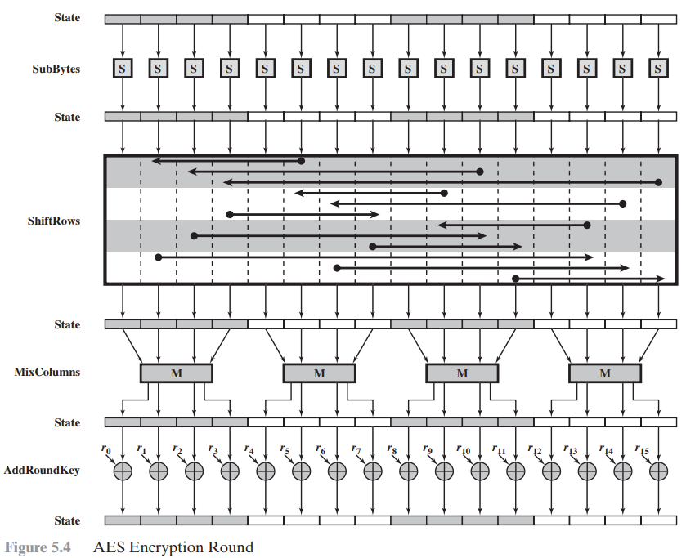
AES Encryption Round

Slide 68
AES Transformation Functions
Substitute Bytes Transformation
FORWARD AND INVERSE TRANSFORMATIONS The forward substitute byte transformation, called SubBytes, is a simple table lookup.
AES defines a matrix of byte values, called an S-box (Table 5.2a), that contains a permutation of all possible 256 8-bit values.
Each individual byte of State is mapped into a new byte in the following way:
The leftmost 4 bits of the byte are used as a row value and the rightmost 4 bits are used as a column value.

Slide 69
These row and column values serve as indexes into the S-box to select a unique 8-bit output value.
For example, the hexadecimal value {95} references row 9, column 5 of the S-box, which contains the value .
Accordingly, the value is mapped into the value .

Slide 70
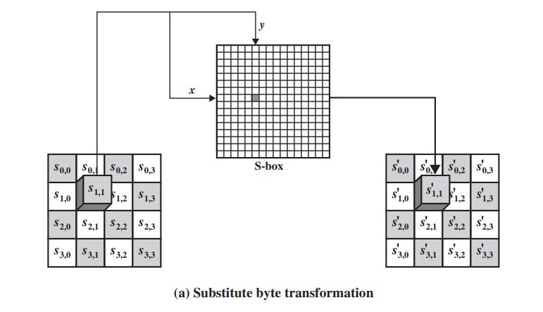

Slide 71
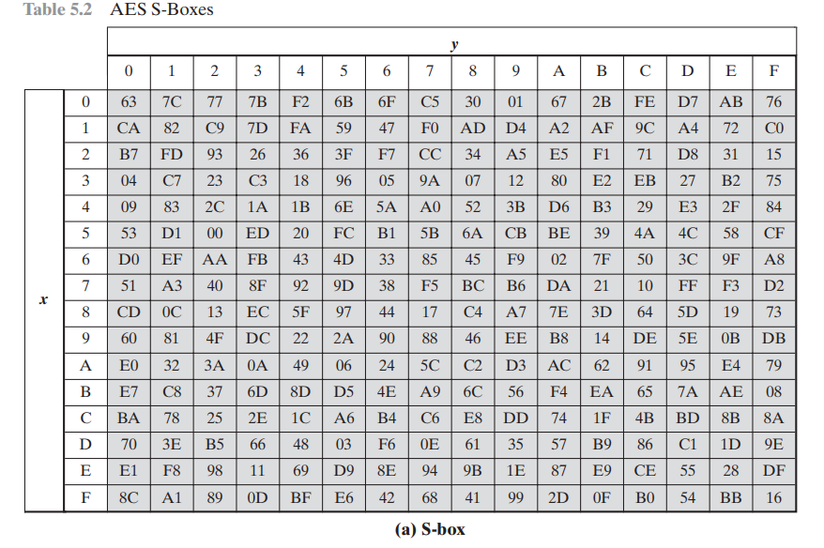

Slide 72
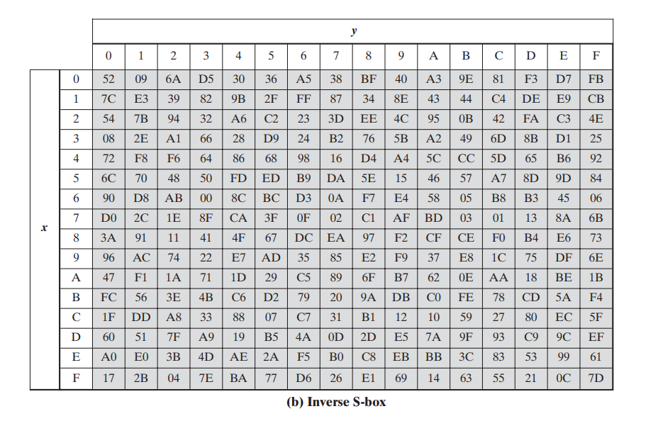

Slide 73
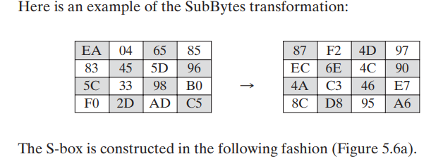

Slide 74
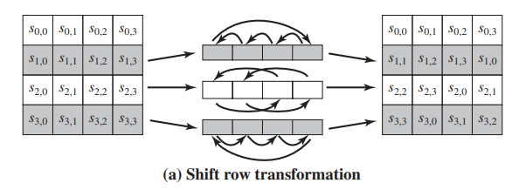
ShiftRows Transformation
The first row of State is not altered. For the second row, a 1-byte circular left shift is performed. For the third row, a 2-byte circular left shift is performed. For the fourth row, a 3-byte circular left shift is performed. The following is an example of ShiftRows.

Slide 75
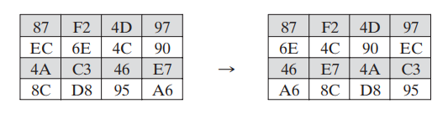
The inverse shift row transformation, called InvShiftRows, performs the circular shifts in the opposite direction for each of the last three rows, with a 1-byte circular right shift for the second row, and so on.

Slide 76
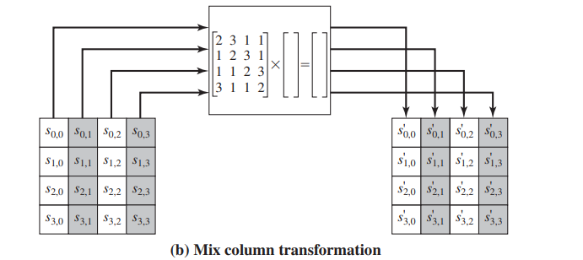
MixColumns Transformation
The forward mix column transformation, called MixColumns, operates on each column individually. Each byte of a column is mapped into a new value that is a function of all four bytes in that column. The transformation can be defined by the following matrix multiplication on State

Slide 77
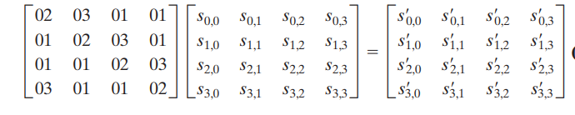
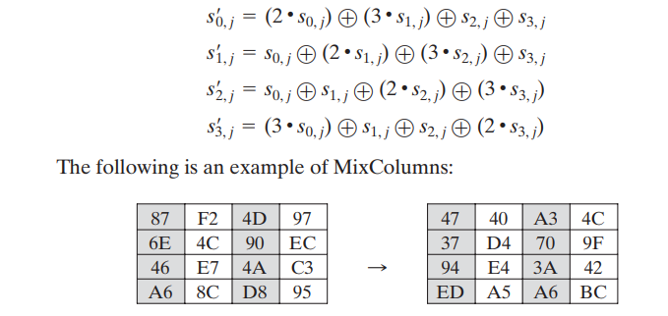

Slide 78
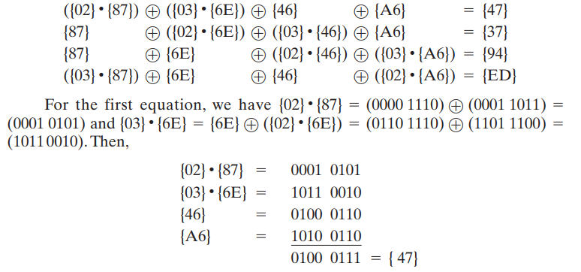

Slide 79
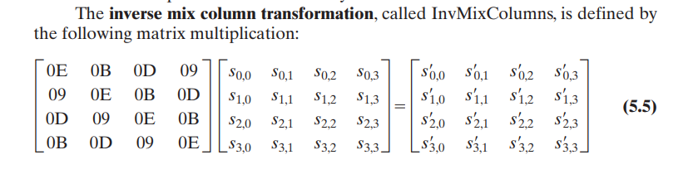

Slide 80
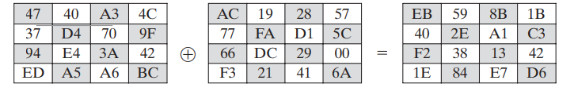
AddRoundKey Transformation
FORWARD AND INVERSE TRANSFORMATIONS In the forward add round key transformation, called AddRoundKey, the 128 bits of State are bitwise XORed with the 128 bits of the round key. The following is an example of AddRoundKey:

Slide 81
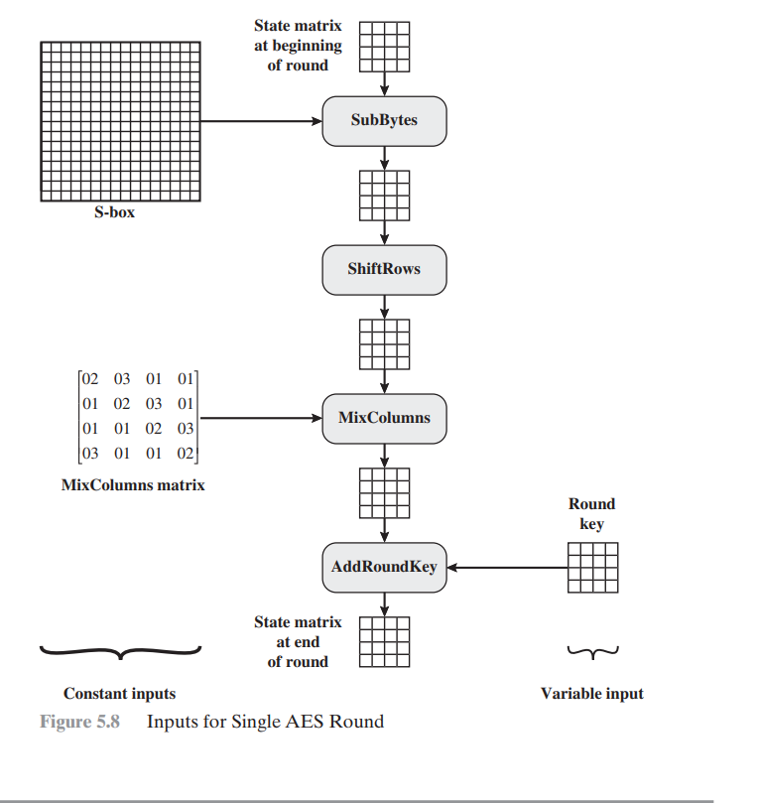

Slide 82
AES Key Expansion Algorithm
The AES key expansion algorithm takes as input a four-word (16-byte) key and produces a linear array of 44 words (176 bytes).
This is sufficient to provide a four-word round key for the initial AddRoundKey stage and each of the 10 rounds of the cipher

Slide 83
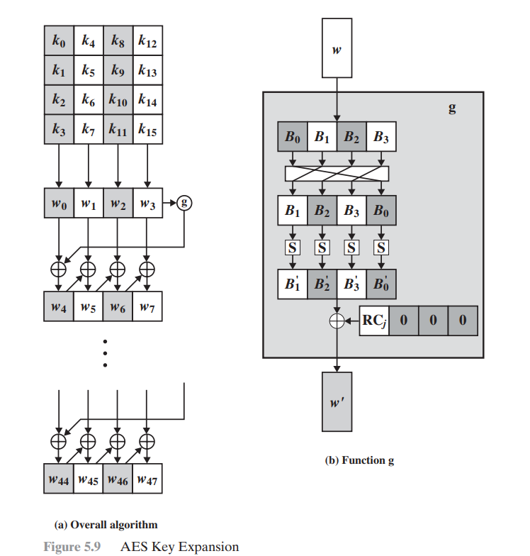

Slide 84
The function g consists of the following subfunctions.
RootWord performs a one-byte circular left shift on a word. This means that an input word is transformed into .
SubWord performs a byte substitution on each byte of its input word, using the S-box
The result of steps 1 and 2 is XORed with a round constant

Slide 85
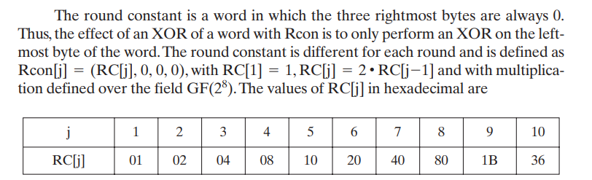

Slide 86
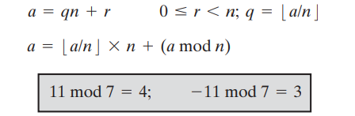
MODULAR ARITHMETIC
The Modulus
If a is an integer and n is a positive integer, we define a mod n to be the remainder when a is divided by n. The integer n is called the modulus. Thus, for any integer , we can rewrite Equation

Slide 87
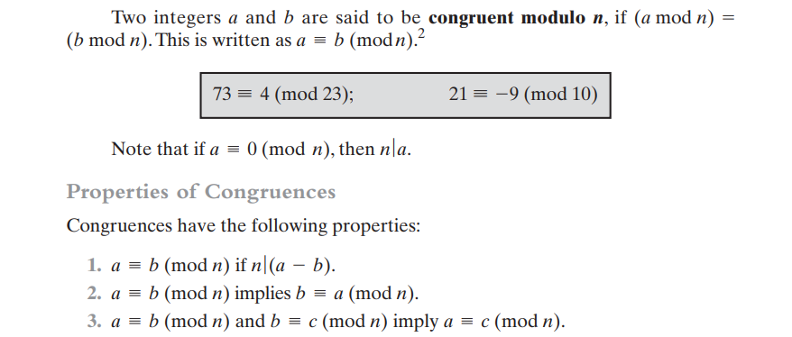

Slide 88
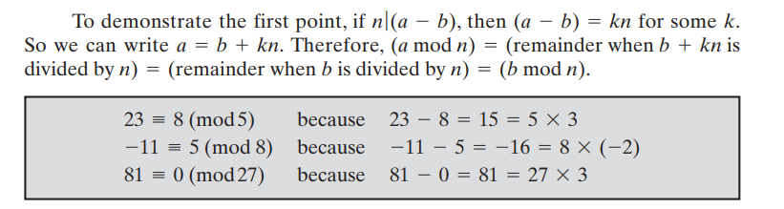

Slide 89
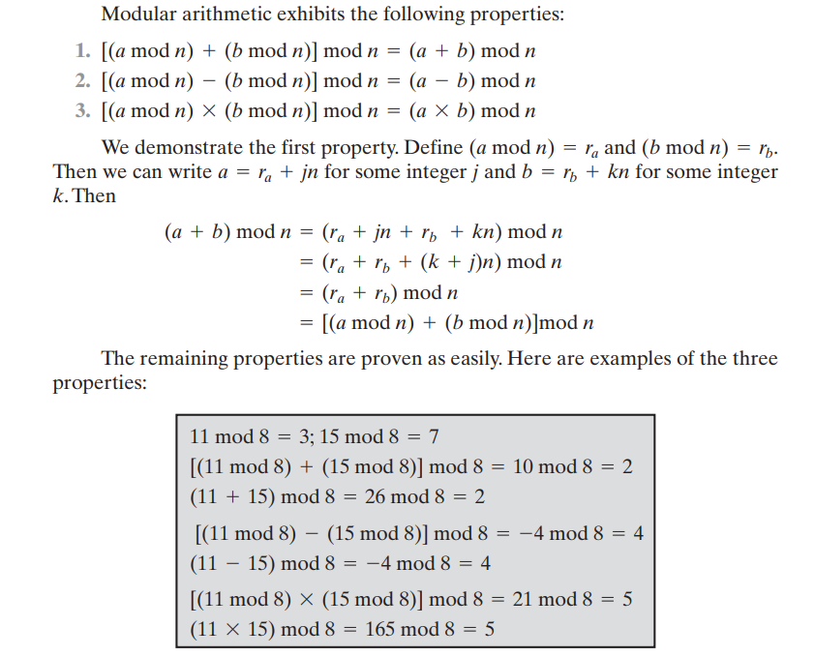
Modular Arithmetic Operations

Slide 90
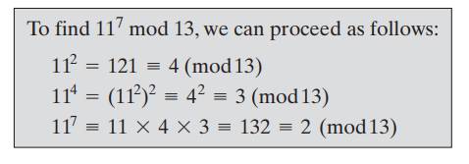

Slide 91
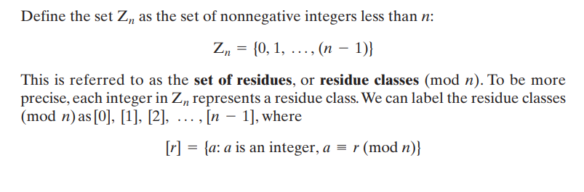
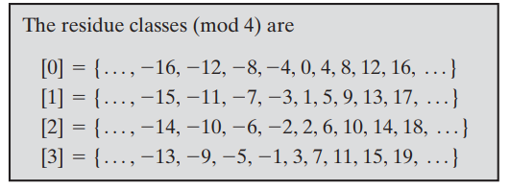
Properties of Modular Arithmetic

Slide 92
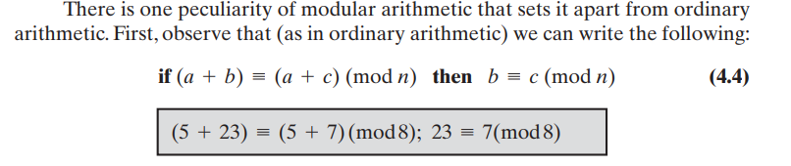
Of all the integers in a residue class, the smallest nonnegative integer is the one used to represent the residue class. Finding the smallest nonnegative integer to which is congruent modulo is called reducing k modulo n

Slide 93
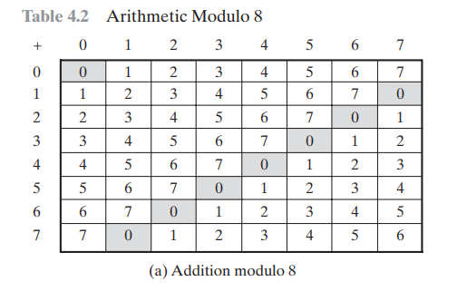

Slide 94
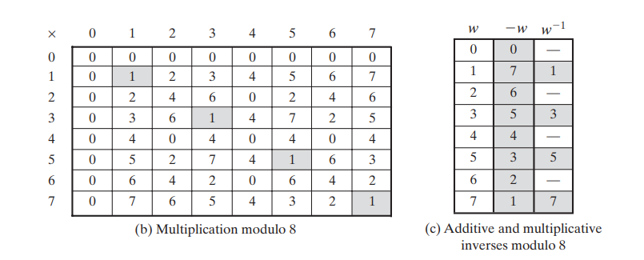

Slide 95
Greatest Common Divisor (GCD)
a common problem in number theory
GCD (a,b) of a and b is the largest number that divides evenly into both a and b
eg GCD(60,24) = 12
often want no common factors (except 1) and hence numbers are relatively prime
eg GCD(8,15) = 1
hence 8 & 15 are relatively prime

Slide 96
Euclid's GCD Algorithm
an efficient way to find the GCD(a,b)
uses theorem that:
GCD(a,b) = GCD(b, a mod b)
With any integers a,b and a>=b>=0
GCD (55,22)=GCD(22,55 mod 22)=gcd(22,11)=11.
Where a=kb+r = r(mod b) or a mod b = r.
Euclid's Algorithm to compute GCD(a,b):
Recursive fn. Euclid(a,b)
If b=0 then
return a;
Else returnEuclid (b,a mod b)
Notes:
Euclid's Algorithm is derived from the observation that if a & b have a common factor d (ie. a=m.d & b=n.d) then d is also a factor in any difference between them, vis: a-p.b = (m.d)-p.(n.d) = d.(m-p.n). Euclid's Algorithm keeps computing successive differences until it vanishes, at which point that divisor has been reached.

Slide 97
Extended Euclid's GCD Algorithm
Imp. Finitefield in Encryption algorithm such as RSA.
For Given integers a,b
The Extended Euclidean algorithm not only calculate the greatest common divisor d but also two additional integers x and y.
i.e., ax+by=d=gcd(a,b)
So, E.E A ends with remainder are 0 but the GCD of a,b is d= gcd (a,b)= rn
Therefore x=xn; y = yn.

Slide 98
Finding Inverses
EXTENDED EUCLID(m, b)
1. (A1, A2, A3)=(1, 0, m);
(B1, B2, B3)=(0, 1, b)
2. if B3 = 0
return A3 = gcd(m, b); no inverse
3. if B3 = 1
return B3 = gcd(m, b); B2 = b^{–1} mod m
4. Q = A3 div B3
5. (T1, T2, T3)=(A1 – Q B1, A2 – Q B2, A3 – Q B3)
6. (A1, A2, A3)=(B1, B2, B3)
7. (B1, B2, B3)=(T1, T2, T3)
8. goto 2
Notes:
An important problem is to find multiplicative inverses in such finite fields. Can show that such inverses always exist, & can extend the Euclidean algorithm to find them as shown. See text for discussion as to why this works.

Slide 99
Inverse of 550 in GF(1759)
Q | A1 | A2 | A3 | B1 | B2 | B3
— | 1 | 0 | 1759 | 0 | 1 | 550
3 | 0 | 1 | 550 | 1 | –3 | 109
5 | 1 | –3 | 109 | –5 | 16 | 5
21 | –5 | 16 | 5 | 106 | –339 | 4
1 | 106 | –339 | 4 | –111 | 355 | 1
Notes:
Example showing how to find the inverse of 550 in GF(1759), from Stallings Table 4.4.

Slide 100
Prime Numbers
Prime numbers only have divisors of 1 and self
they cannot be written as a product of other numbers
note: 1 is prime, but is generally not of interest
eg. 2,3,5,7 are prime, 4,6,8,9,10 are not
prime numbers are central to number theory
list of prime number less than 200 is:
2 3 5 7 11 13 17 19 23 29 31 37 41 43 47 53 59 61 67 71 73 79 83 89 97 101 103 107 109 113 127 131 137 139 149 151 157 163 167 173 179 181 191 193 197 199

Slide 101

Prime Factorisation
to factor a number n is to write it as a product of other numbers: n=a × b × c
note that factoring a number is relatively hard compared to multiplying the factors together to generate the number
the prime factorisation of a number n is when its written as a product of primes
eg. 91=7×13 ; 3600=2⁴×3²×5²
Notes:
The idea of "factoring" a number is important - finding numbers which divide into it. Taking this as far as can go, by factorising all the factors, we can eventually write the number as a product of (powers of) primes - its prime factorisation.

Slide 102
Relatively Prime Numbers & GCD
two numbers a, b are relatively prime if have no common divisors apart from 1
eg. 8 & 15 are relatively prime since factors of 8 are 1,2,4,8 and of 15 are 1,3,5,15 and 1 is the only common factor
conversely can determine the greatest common divisor by comparing their prime factorizations and using least powers
eg. 300=2²x3¹×5² 18=2¹×3²
hence GCD(18,300)=2¹×3¹×5⁰=6

Slide 103
Fermat's Theorem
If p is prime and a is a positive integer not divisible by p, then
a^{p-1} mod p = 1
While gcd(a,p)=1
also known as Fermat’s Little Theorem
Alternatively We can say
If p is a prime and a is a positive integer, then a power n = a (mod p)
Two no.are relatively prime if they have no prime factors in common.i.e., only one divisor and GCD is also 1.
useful in public key and primality testing

Slide 104
Example
P=5 and a=2
P=13 and a=11
P=19 and a=7

Slide 105
Euler Totient Function ø(n)
when doing arithmetic modulo n
complete set of residues is: 0..n-1
reduced set of residues is those numbers (residues) which are relatively prime to n
eg for n=10,
complete set of residues is {0,1,2,3,4,5,6,7,8,9}
reduced set of residues is {1,3,7,9}
number of elements in reduced set of residues is called the Euler Totient Function ø(n)

Slide 106
Euler Totient Function ø(n)
to compute ø(n) need to count number of elements to be excluded
in general need prime factorization, but
for p (p prime) ø(p) = p-1
for p.q (p,q prime) ø(p.q) = (p-1)(q-1)
eg.
ø(37) = 36
ø(21) = (3–1)×(7–1) = 2×6 = 12

Slide 107
Euler's Theorem
a generalisation of Fermat's Theorem
a^{ø(n)}mod N = 1
where gcd(a,N)=1 for every a,n are relatively prime.
eg.
a=3;n=10; ø(10)=4;
hence 3⁴ = 81 = 1 mod 10
a=2;n=11; ø(11)=10;
hence 2¹⁰ = 1024 = 1 mod 11

Slide 108
Primality Testing
often need to find large prime numbers
traditionally done using trial division
ie. divide by all numbers (primes) in turn less than the square root of the number
only works for small numbers
alternatively can use statistical primality tests based on properties of primes
for which all primes numbers satisfy property
but some composite numbers, called pseudo-primes, also satisfy the property

Slide 109
Miller Rabin Algorithm
a test based on Fermat’s Theorem
algorithm is:
TEST (n) is:
1. Find integers k, q, k > 0, q odd, so that (n–1)=2^{k}q
2. Select a random integer a, 1<a<n–1
3. if a^{q} mod n = 1 then return (“maybe prime");
4. for j = 0 to k – 1 do
5. if (a^{2jq} mod n = n-1)
then return(" maybe prime ")
6. return ("composite")

Slide 110
Chinese Remainder Theorem
used to speed up modulo computations
working modulo a product of numbers
eg. mod M = m₁m₂..m_{k}
Chinese Remainder theorem lets us work in each moduli m_{i} separately
since computational cost is proportional to size, this is faster than working in the full modulus M
Notes:
The CRT is so called because it is believed to have been discovered by the Chinese
mathematician Sun-Tse in around 100 AD.
It is very useful in speeding up some operations in the RSA public-key scheme.

Slide 111


Chinese Remainder Theorem
can implement CRT in several ways
It is possible to reconstruct the integers in a certain range from their residues modulo to attain set of pairwise relatively prime moduli.
to compute (A mod M) we can first compute all (a_{i} mod m_{i}) separately and then combine results to get answer using:
Notes:
See worked examples in text.

Slide 112

Example
Find X for the given set of congruent equations using CRT
X ≡ 2 (mod 3)
X ≡ 3 (mod 5)
X ≡ 2 (mod 7)
Solution:
a1=2, a2=3 and a3=2.
n1=3, n2=5, n3=7
N=n1 x n2 x n3 = 3 x 5 x 7 = 105
Now N1=N/n1 = 105/3 = 35
N1* ${N1}^{−1}$ = 1 mod n1
${N1}^{−1}$ = 2

Slide 113

N2=N/n2 = 105/5 = 21
${N2}^{−1}$ = 1
N3 = N/n3 = 105/7 = 15
${N3}^{−1}$=1
X= ((a1*N1*${N1}^{−1}$) + (a2*N2*${N2}^{−1}$) + (a3*N3*${N3}^{−1}$) ) mod N
X = ((2*35*2) + (3*21*1) + (2*15*1)) mod 105
X= 23

Slide 114
A Box contains gold coins. If the coins are equally divided among three friends, two coins are left over, If the coins are equally divided among five friends, three coins are left over If the coins are equally divided among seven friends, two coins are left over. If the box holds smallest number of coins that meets these conditions, how many coins are there? (Hint : Use Chinese Remainder Theorem).
State Chinese Remainder theorem and find the value of X for the given set of congruent equations using Chinese Remainder theorem.
X ≡ 1(mod 5)
X ≡ 2(mod 7)
X ≡ 3(mod 9)
X ≡ 4(mod 11)

Slide 115


